Slide 1

Applying Artificial Bee Colony optimization algorithm for the Field Technician Scheduling Problem comp594 Han Wang 11/30/2016

Slide 2
1. Field Technician Scheduling Problem (FTSP) We are given: * a set of tasks * a set of technicians Our goal: maximize the total priority of all scheduled tasks

Slide 3
Constraints: 1) Each task has a specific time window. Any task scheduled by a technician can only be executed in this time window. 2) Each technician has a specific work time window. Any technician cannot work earlier, cannot work overtime. 3) Technicians have to take some travel time from the location of one task to that of next task.

Slide 4
More constraints: 4) For each task, only technicians who have a matching skill level can schedule it. 5) Each task can only be scheduled at most once. -> Generated solutions should meet these requirements. We use conflict check to confirm our solutions’ correctness.

Slide 5
2. Artificial Bee Colony (ABC) Optimization Algorithm Idea: * one solution of problem = one food source for bees * bees work on same or different food sources Bee types: employed bee, onlooker, scout bee Purpose: find optimized solution (food source)

Slide 6
Basic ABC algorithm: Initial food sources are produced for all employed bees REPEAT Each employed bee goes to a food source in her memory and determines a neighbor source, then evaluates its nectar amount and dances in the hive Each onlooker watches the dance of employed bees and chooses one of their sources depending on the dances, and then goes to that source. After choosing a neighbor around that, she evaluates its nectar amount. Abandoned food sources are determined and are replaced with the new food sources discovered by scouts. The best food source found so far is registered. UNTIL (requirements are met) https://en.wikipedia.org/wiki/Artificial_bee_colony_algorithm

Slide 7
Heuristics we use: 1) Shortest Travel Time (STT) 2) Random Solution (RS) 3) Add one task WithOut Drop (AWOD) 4) Add one task With Drop (AWD) -> These four are used in basic ABC algorithm

Slide 8
More heuristics to use: 1) EXchange Two tasks among technicians in same solution (EXT) 2) EXchange Whole technicians’ tasks among solutions (EXW) 3) Shrink Scheduled Tasks (SST) -> These are local search methods in our project

Slide 9
4) Select Worst Task (SWT) 5) Select Best Task (SBT) -> These two are greedy heuristics during the process 6) Combination of Constructive method and Local search (CLL) -> Leave some initial solutions empty and try constructive method in each step during the process

Slide 10
Mutant algorithms of the basic ABC: 1) Mutant Algorithm with Local search (MAL) 2) Mutant Algorithm with Combination of Constructive and Local Search (MACCL) -> We will compare their performances with basic ABC

Slide 11
More mutant algorithms: 1) MAL with Select Worst task (MASW) 2) MASW with Select Best by Priority / Process Time (MASWSBP) 3) MASW with Select Best by Objective function (MASWSBO) -> We will compare their performances since they have common SWT heuristic.

Slide 12
Big boss mutant algorithm: MASWSBO with Combination of Constructive and Local search (MASWSBOCCL) -> It uses all heuristics listed before -> we hope it would be the most powerful one -> guess if it’s true?

Slide 13
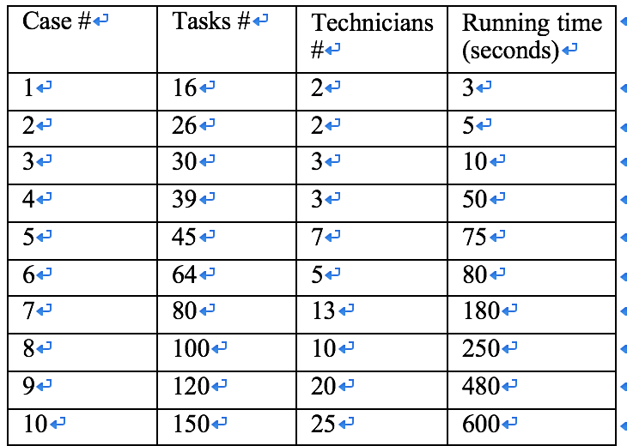
3. Experiments Data set we will use:

Slide 14
In our experiments, for each instance we will record: 1) the best initial solution (INIT) 2) the best solution generated by our algorithm (ABC) 3) the best solution (GA) provided by Damm et al. [1].

Slide 15
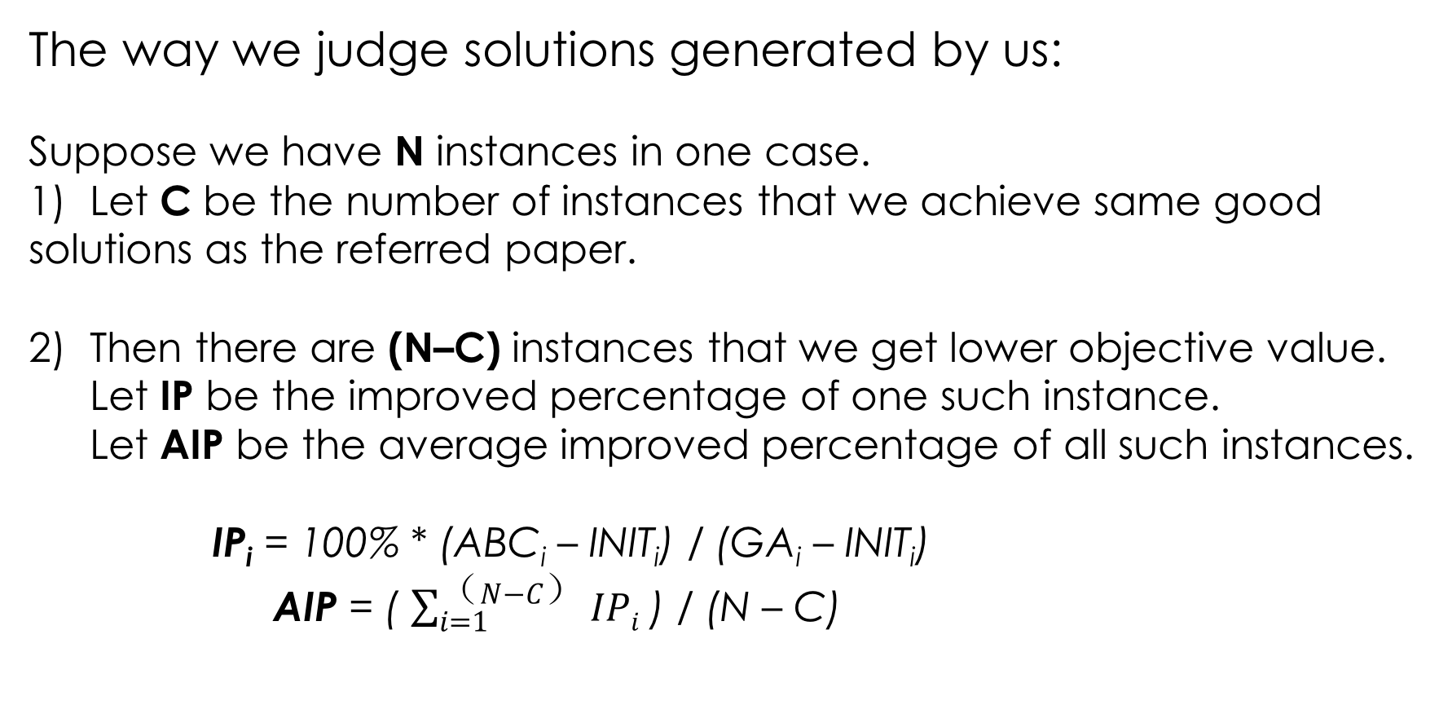
The way we judge solutions generated by us: Suppose we have N instances in one case. 1) Let C be the number of instances that we achieve same good solutions as the referred paper. 2) Then there are (N–C) instances that we get lower objective value. Let IP be the improved percentage of one such instance. Let AIP be the average improved percentage of all such instances. IP_{i} = 100% * (ABC_{i} – INIT_{i}) / (GA_{i} – INIT_{i}) AIP = ( $\sum_{i=1}^{（N−C）}{IPi}$ ) / (N – C)

Slide 16
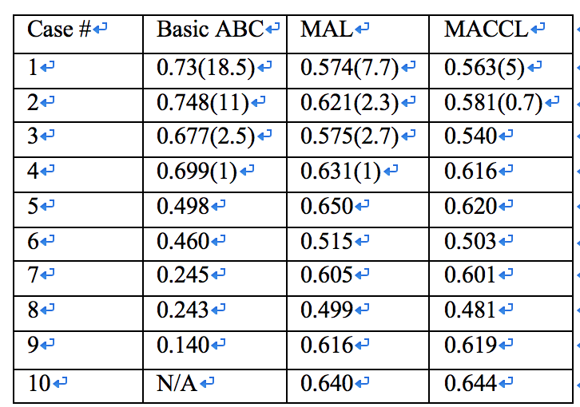
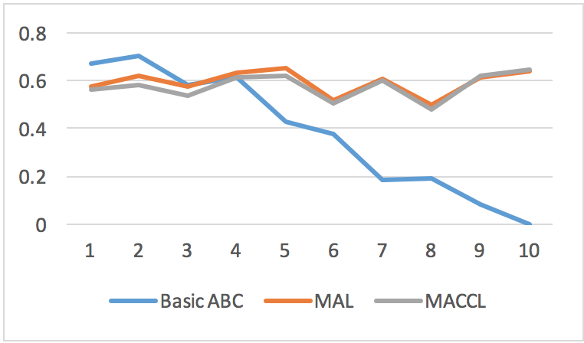
a. Comparison of basic ABC, MAL and MACCL

Slide 17
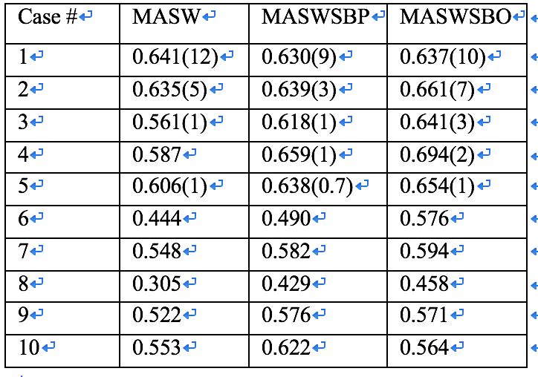
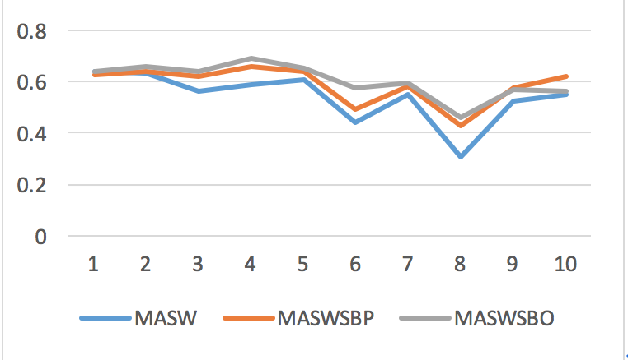
b. Comparison of MASW, MASWSBP, and MASWSBO

Slide 18
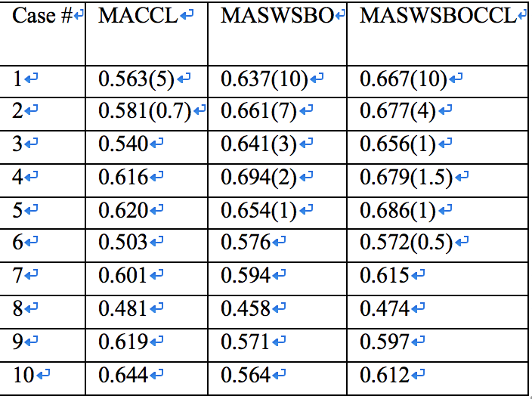
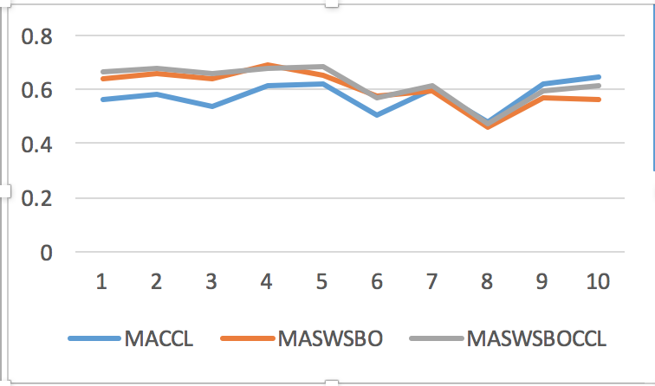
c. Comparison of MACCL ,MASWSBO, and MASWSBOCCL

Slide 19
d. Experiments on stopping criterion * we were using the same stopping criterion which is the specific running time for each instance * we want to find a new way to stop the loop, to shorten experiments time but get similar results. -> use abandoned solution comparison

Slide 20
Fact in ABC: if we detect one solution that is not improved after a hard-coded count (say it HC), this solution will be abandoned. Our approach: We are going to check if the abandoned solution is becoming better. If we find that after some consecutive count (say it CC), the abandoned solution is not improved, we will stop the loop. Let LC be the limit count (parameter) when we stop the loop. We generate the mutant algorithm of MAL (name it MALS) for this experiment.

Slide 21
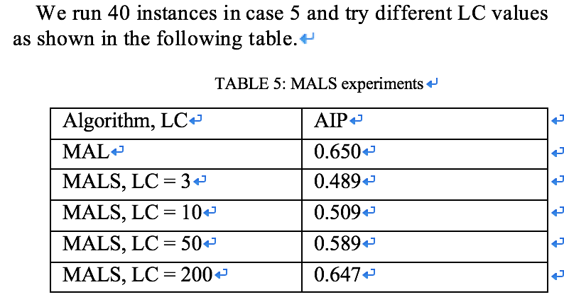

Slide 22
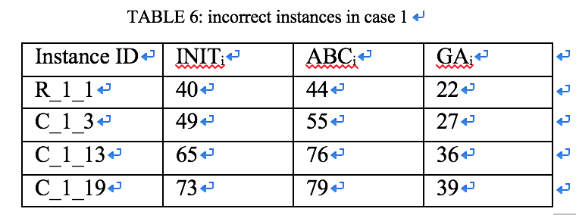
e. Consider a few experimental results (referred paper) incorrect * reason: for some instances the best objective value in the referred paper is even smaller than that of the best initial solution we generated. We use conflict check to ensure correctness of solutions.

Slide 23
4. conclusions: 1) We applied the basic ABC optimization and some mutants of it by using some heuristics to the instances of FTSP. We are able to achieve around 60% improvement from the best initial solution. 2) MASWSBOCCL, the mutant with all presented heuristics works best and performs consistently from small instances to large instances. 3) We can stop the running loop earlier than the specific time to achieve similar results.

Slide 24
Future work: 1) Do more experiments to find the best parameter for this approach. 2) Try some more heuristics and optimize the process of our algorithm to seek better solutions when running the same data set.

Slide 25
References [1] Damm R B, Resende M G C, Ronconi D P. A biased random key genetic algorithm for the field technician scheduling problem[J]. Computers & Operations Research, 2016, 75: 49-63. [2] Karaboga D, Basturk B. Artificial bee colony (ABC) optimization algorithm for solving constrained optimization problems[C]//International Fuzzy Systems Association World Congress. Springer Berlin Heidelberg, 2007: 789-798.

